Slide 1
To analyse the motion on inclined planes
Do Now
A student wanted to see how smooth a ramp was. A 2kg ball was released from rest down a ramp of length 15m and angle 15º. A student measured the time taken for the ball to roll down the ramp as 3.25s.
Can the ramp be assumed to be frictionless? Why / why not?
Notes:
Method
- Calculate net force acting on the ball assuming no friction (this is the parallel component of the weight force)
- Use F=ma to calculate the acceleration acting on the ball
- use s=ut+0.5at^2 to calculate the time it would take the ball to roll down the slope
- this is the theoretical time if there is no friction. There is no faster time possible.
If the measured time approximately equals the theoretical time → can assume frictionless
If the measured time is higher than the theoretical time → cannot assume frictionless
If the measured time is less than the theoretical time → something is wrong. You broke physics.

Slide 2
To analyse the motion of projectiles launched horizontally
Success Criteria
For projectiles:
I can draw a free body diagram
I can calculate net force and acceleration
I can qualitatively describe the impact of air resistance

Slide 3


To analyse the motion of projectiles launched horizontally
Do Now
1. Draw an arrow representing the velocity of the bullet
2. In a different colour, draw a free body diagram of the bullet
Notes:
After the bullet is fired, the gun no longer exerts force on it. In fact (ignoring air resistance), there is no horizontal force acting on the bullet. The only force acting on the bullet is the weight force, acting down.

Slide 4
To analyse the motion of projectiles launched horizontally
Do Now
1. Draw an arrow representing the velocity of the bullet
2. In a different colour, draw a free body diagram of the bullet
F_{air}
v
F_{g}
Notes:
After the bullet is fired, the gun no longer exerts force on it. In fact (ignoring air resistance), there is no horizontal force acting on the bullet. The only force acting on the bullet is the weight force, acting down.
Note: picture assumes just after bullet has been fired

Slide 5
To analyse the motion of projectiles launched horizontally
Content Development
After the bullet is fired, the gun no longer exerts force on it. In fact, ignoring air resistance, there is no horizontal force acting on the bullet at all.
The only force acting on the bullet is the force due to gravity.
F_{g}
F_{g} is constant and always directed vertically downwards.

Slide 6
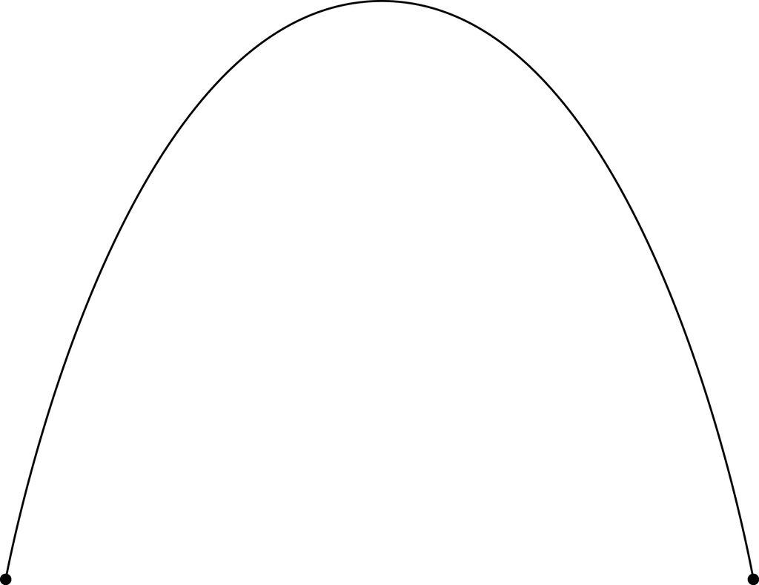
To analyse the motion of projectiles launched horizontally
Content Development
The horizontal velocity is constant!
The bullet stops because it hits the ground.
v
v
a
v
a
F_{g}
F_{g}
a
F_{g}
v
a
F_{g}
v
a
F_{g}
F_{g} is constant and always directed vertically downwards. This is the net force. Therefore, the acceleration is constant and straight down. The velocity of the bullet moves down throughout the flight.

Slide 7
To analyse the motion of projectiles launched horizontally
Content Development
The projectile has a constant acceleration of 9.80 ms⁻² downwards throughout its motion.
v
v
a
v
a
F_{g}
F_{g}
a
F_{g}
v
a
F_{g}
v
a
F_{g}
The beauty of this is that we can analyse the projectile’s motion in the vertical direction separately to the motion in the horizontal direction.

Slide 8

To analyse the motion of projectiles launched horizontally
You Do
Calculate how long for the bullets to hit the ground.
v
a
a
F_{g}
F_{g}
1.50m
Notes:
s = ut + ½ at²
-1.5 = ½ * 9.8 * t²
t = sqrt(-1.5 / -4.9) = 0.553 s

Slide 9
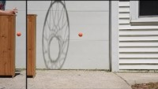
To analyse the motion of projectiles launched horizontally
Content Development

Slide 10
To analyse the motion of projectiles launched horizontally
Tips
Draw a diagram
Write out the vertical and horizontal information separately
Horizontal:
  horizontal projectile velocity is constant
  v_{av} = s/t
Vertical:
  constant acceleration downwards of 9.80 ms⁻²
  use equations for constant acceleration
Clearly specify and state which direction is positive and negative

Slide 11
To analyse the motion of projectiles launched horizontally
Worked Example
A 10kg cannonball is shot horizontally from the battlements, 40m off the ground, at a speed of 120 ms⁻¹.
Calculate the time that the cannonball takes to land
Calculate the horizontal distance the cannonball travelled
Calculate the velocity of the cannonball as it lands.

Slide 12
To analyse the motion of projectiles launched horizontally
Worked Example
A 10kg cannonball is shot horizontally from the battlements, 40m off the ground, at a speed of 120 ms⁻¹.
Calculate the time that the cannonball takes to land
Notes:
s = ut + ½ at²
-40 = ½ * 9.8 * t²
t = sqrt(-40 / -4.9) = 2.86 s

Slide 13
To analyse the motion of projectiles launched horizontally
Worked Example
A 10kg cannonball is shot horizontally from the battlements, 40m off the ground, at a speed of 120 ms⁻¹.
Calculate the horizontal distance the cannonball travelled
Notes:
v_{av} = s/t
120 = s / 2.86
s = 343.2 m

Slide 14
To analyse the motion of projectiles launched horizontally
Worked Example
A 10kg cannonball is shot horizontally from the battlements, 40m off the ground, at a speed of 120 ms⁻¹.
Calculate the velocity of the cannonball as it lands
Notes:
Horizontally, v_{h} = u_{h} = 120 m/s
Vertically: v = u + at = 0 + (-9.80) * 2.86 = -28.0 m/s
Use pythag: v = sqrt(v_{h}² + v_{v}²) = sqrt(120^2 + -28^2) = 123 m/s
Theta = tan⁻¹ (28.0 / 120) = 13.1 deg below the horizontal

Slide 15
To analyse the motion of projectiles launched horizontally
Your turn
A golf ball of mass of 100g is hit horizontally from the top of a 20.0m high cliff with speed of 20.0 m/s. Ignore air resistance.
Calculate the time that the ball takes to land
Calculate the horizontal distance the ball travelled
Calculate the velocity of the ball as it lands.
Notes:
s = ut + ½ at²
-20 = ½ * 9.8 * t²
t = sqrt(-20 / -4.9) = 2.02 s
v_{av} = s/t
20 = s / 2.02
s = 40.4 m
Horizontally, v_{h} = u_{h} = 20.0 m/s
Vertically: v = u + at = 0 + (-9.80) * 2.02 = -19.8 m/s
Use pythag: v = sqrt(v_{h}² + v_{v}²) = sqrt(20^2 + -19.8^2) = 28.1 m/s
Theta = tan⁻¹ (19.8 / 20) = 44.7 deg below the horizontal

Slide 16
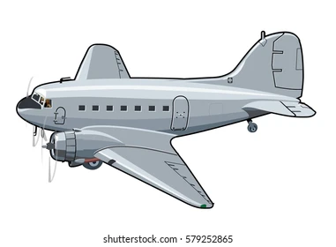
To analyse the motion of projectiles launched horizontally
Your turn
A bomber is travelling horizontally at 300 ms⁻¹ at an altitude of 2.50 km towards its designated ground target. To hit the target, how far ahead should the target be when the bomb is dropped? (ignore air resistance)
Notes:
Calculate how long to fall to the ground (s = ut + ½ at²) = 22.6s
Calculate distance travelled in that time (v = s / t) = 6780m

Slide 17
To analyse the motion of projectiles launched horizontally
Impact of air resistance
As an object moves through the air, it encounters some degree of air resistance. Air resistance is a force caused by the air that opposes the motion of an object. It is the result of collisions of the object’s leading surface with air molecules.
Air resistance is a function of:
The speed of the object
The cross-sectional area of an object
The aerodynamics of an object
The density of the air
Impact on air resistance
stronger
stronger
weaker
stronger

Slide 18
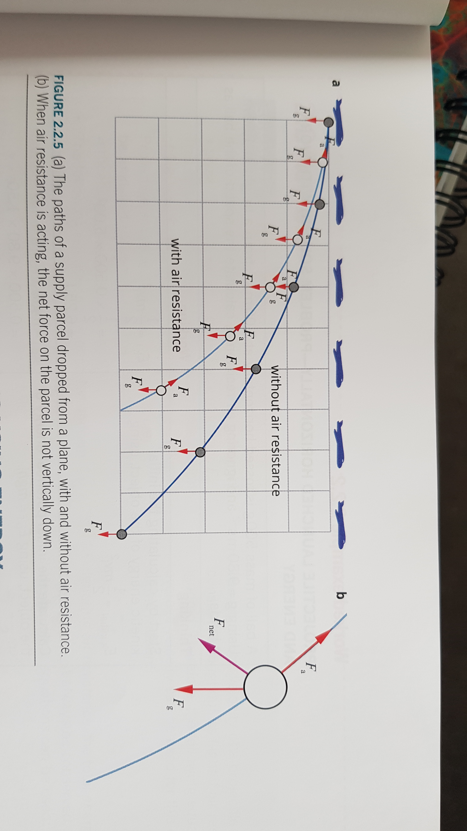
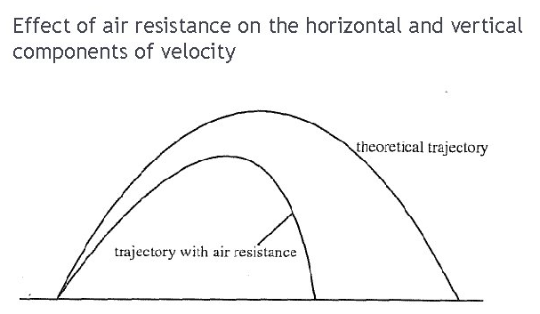
To analyse the motion of projectiles launched horizontally
Impact of air resistance
If air resistance is ignored, an object will follow a parabolic path.
With air resistance, the object will fall more slowly and over a shorter path.

Slide 19
To analyse the motion of projectiles launched horizontally
Success Criteria
For projectiles:
I can draw a free body diagram
I can calculate net force and acceleration
I can qualitatively describe the impact of air resistance

Slide 20
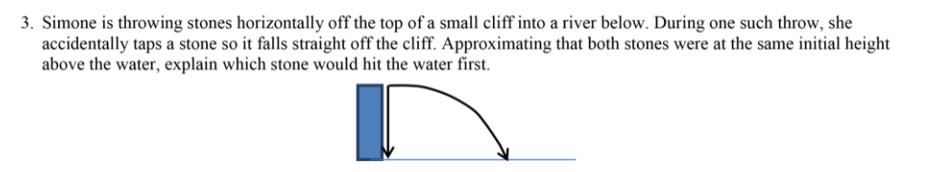
To analyse the motion of projectiles launched horizontally
Homework
Notes:
Calculate how long to fall to the ground (s = ut + ½ at²) = 22.6s
Calculate distance travelled in that time (v = s / t) = 6780m

